Slide 1
Descriptive statistics

Slide 2
What is Descriptive Statistics?
The study of numerical and graphical ways to collection, describe ,display and Summarization of the data is called descriptive statistics.
NUMERICAL | GRAPHICAL
Central Tendency Of Data | Univariate (Histogram, bar graph,boxplot…etc)
Dispersion /Spread of Data | Bivariate(scatter plot..etc)
Skewness | Multivariate(heatmap..etc)
Kurtosis
Inter Quartile Range ( IQR )/Percentiles
Relationships

Slide 3
Scope of Descriptive Analytics?
Describe ,Display and Summarization
Stages of Data Analytics:
Descriptive
Analytics
Diagnostic Analytics
Predictive Analytics
Prescriptive Analytics

Slide 4
Numerical Analysis
Measure of Central Tendency of Data/First Moment Business Decision
Measure of Dispersion/ Second Moment Business Decision
Skewness/ Third Moment Business Decision
Kurtosis/ Fourth Moment Business Decision
IQR/Percentiles

Slide 5
Descriptive statistics vs Inferential statistics
Descriptive statistics | Inferential statistics
Descriptive statistics involves summarizing and describing the main features of a dataset without drawing any conclusions beyond the data itself | Inferential statistics involves making inferences or drawing conclusions about a population based on a sample of data
It focuses on organizing, presenting, and summarizing data to gain insights and provide a concise representation of the data set. | It uses sample data to make predictions, generalizations, or hypotheses about the larger population from which the sample is drawn.
Descriptive statistics provide information about the central tendency (mean, median, mode), dispersion (range, variance, standard deviation), and shape of the data distribution (skewness, kurtosis). | It involves techniques such as hypothesis testing, confidence intervals, and regression analysis.

Slide 6
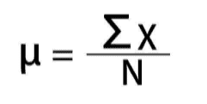
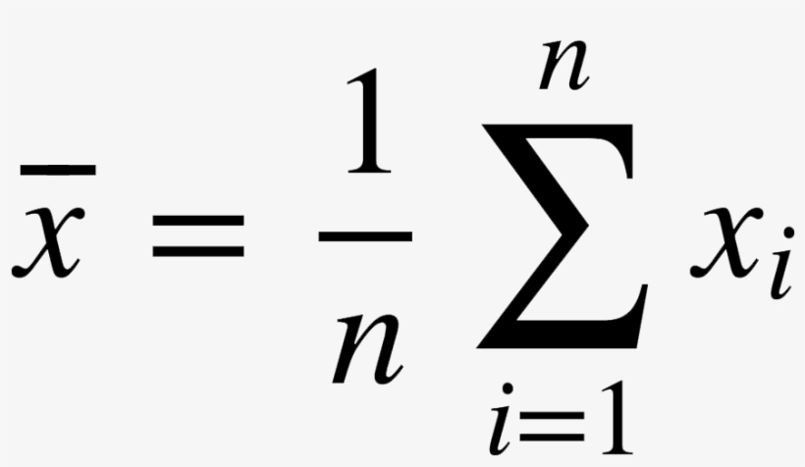
Measure of Central Tendency
Measures of central tendency are statistical measures that provide a single value to represent the center or typical value of a dataset.
Mean/Average: Note: Affected by outliers
Median: The median is the middle value in an ordered dataset.
Mode: The value or values that appear most frequently in a dataset

Slide 7

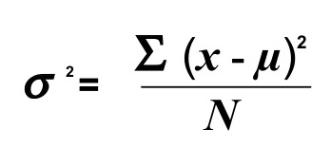
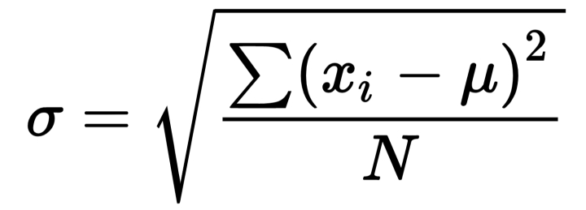
Measures of dispersion/ spread
Variance: Variance is a measure of how much the data points in a dataset vary around the mean.
Standard Deviation: is a widely used measure of dispersion that represents the average amount by which the data points deviate from the mean.
Range: calculated by subtracting the minimum value from the maximum value

Slide 8
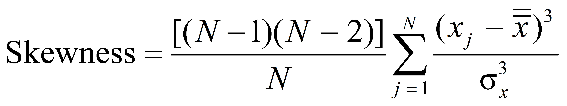
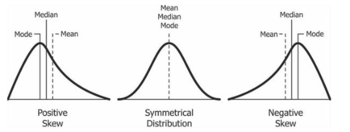
Measure of Skewness
Skewness is a statistical measure that quantifies the asymmetry of a probability distribution or the shape of a dataset.

Slide 9
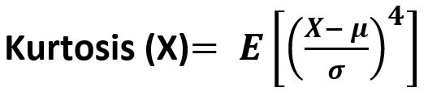
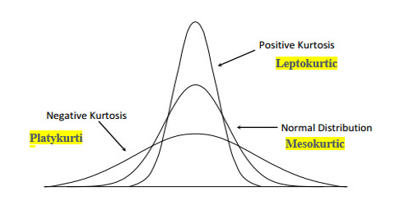
Measure of Kurtosis:
Kurtosis is a statistical measure that describes the shape of a probability distribution or the peakedness and thickness of the tails of a dataset relative to a normal distribution.

Slide 10
Relationships:
Relationships refer to the associations or connections between variables in a dataset.
Positive Relationship
Negative Relationship
No Relationship
Linear Relationship
Non-linear Relationship
Measures:
Covariance
Correlation
Scatter Plot
Heatmap

Slide 11
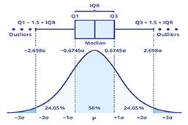
IQR(Interquartile range)

